Slide 1
Improving Pytesseract OCR using Image Processing
Name - Yattandeep Singh
Roll Number - M220287CS

Slide 2
OUTLINE
1. Introduction
2. Methodology
3. Before Processing Result
4. Gray scale image
5. Threshold
6. Noise Removal(Median Blur , Erosion , Dilation , Morphological opening and closing )
7. Result
8. Limitaions

Slide 3
Introduction
What is an OCR?
OCR stands for Optical Character Recognition. It is a technology that enables the digital conversion of printed or handwritten text into machine-readable text.
Why to use Image processing in OCR ?
OCR systems can be imperfect, especially when the quality of the input image is poor.Image processing techniques can significantly improve the accuracy and reliability of OCR systems.

Slide 4
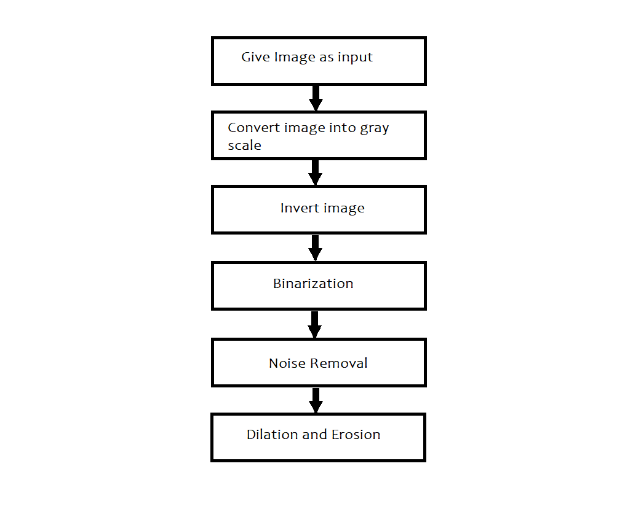
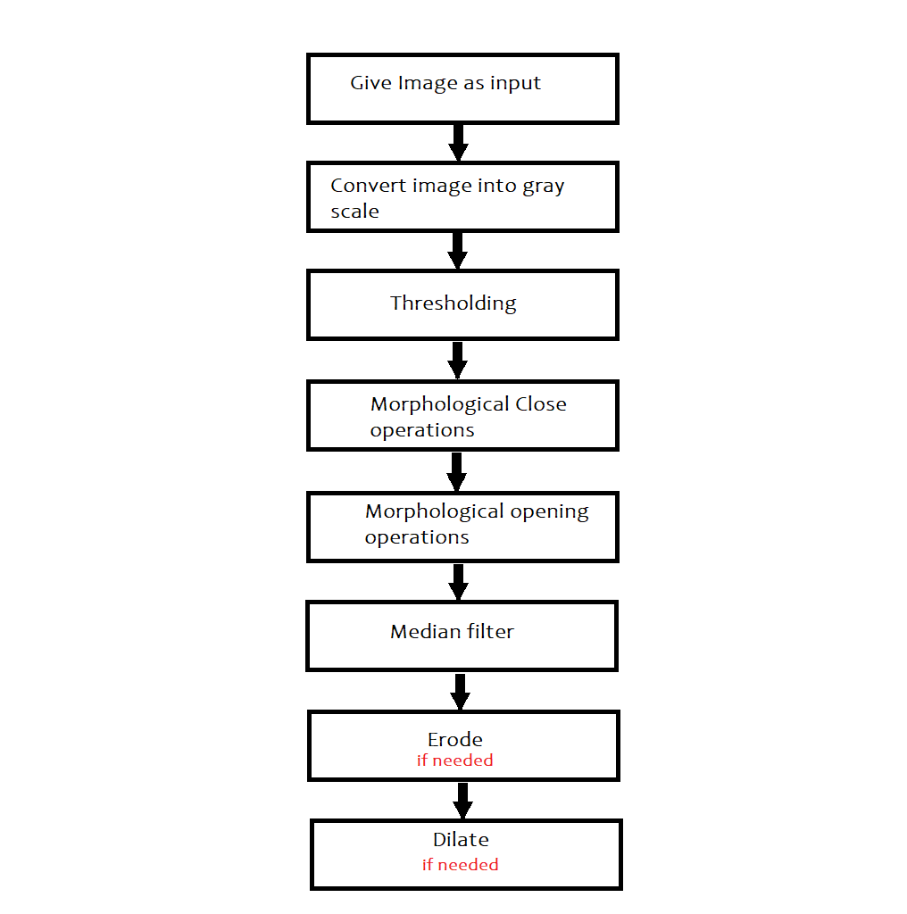
Methodology

Slide 5
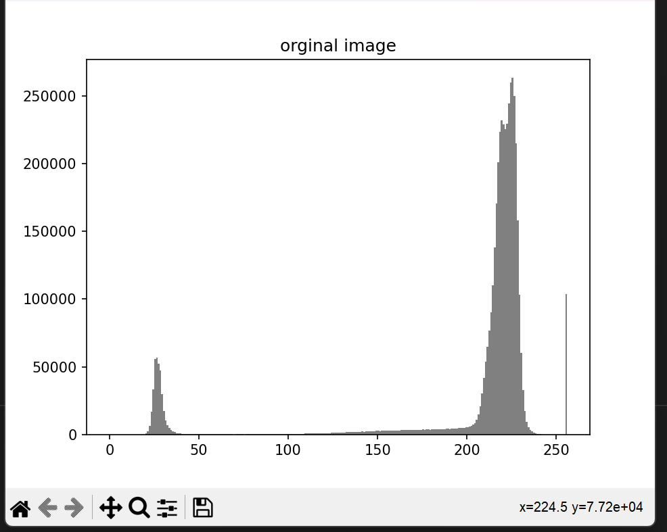
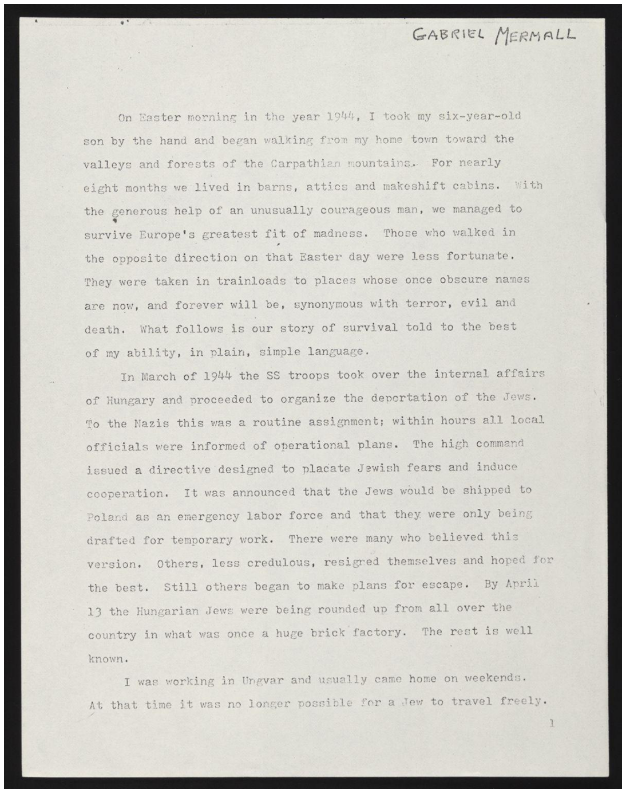
Input image

Slide 6
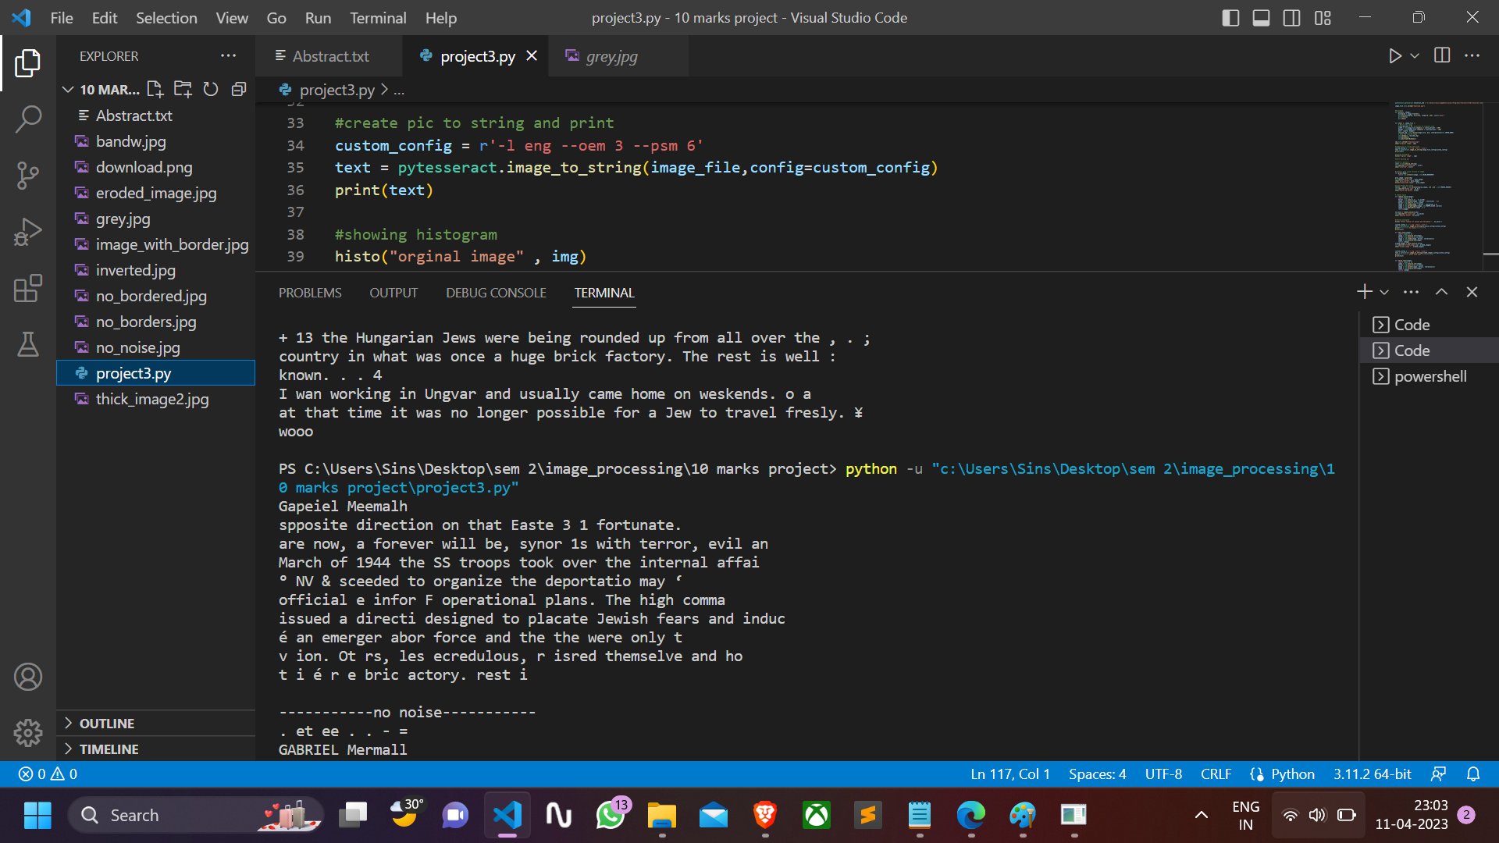
Result by ocr before processing

Slide 7
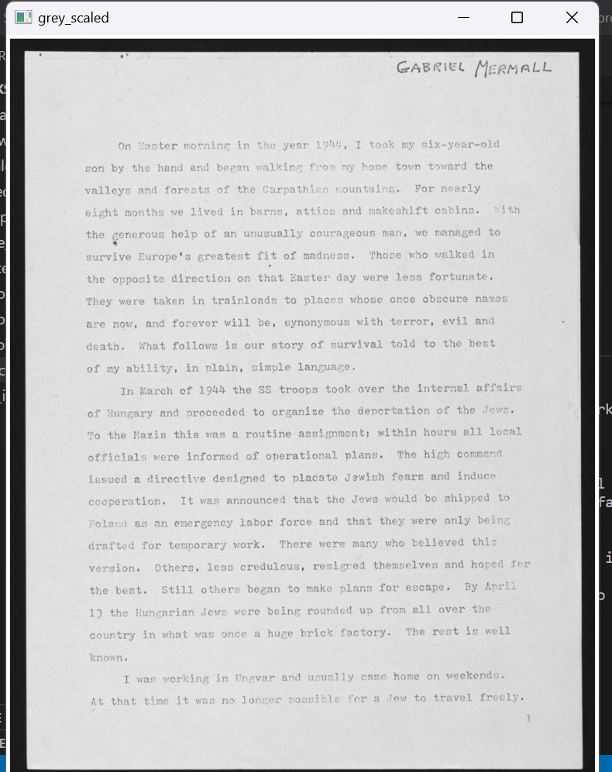
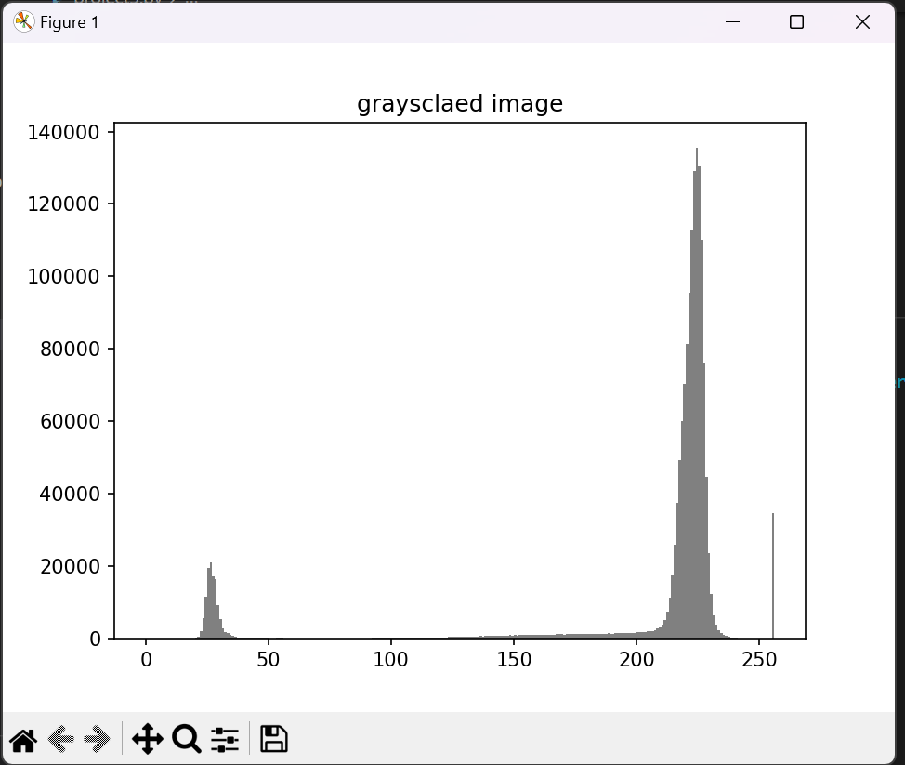
Converted into grayscale

Slide 8
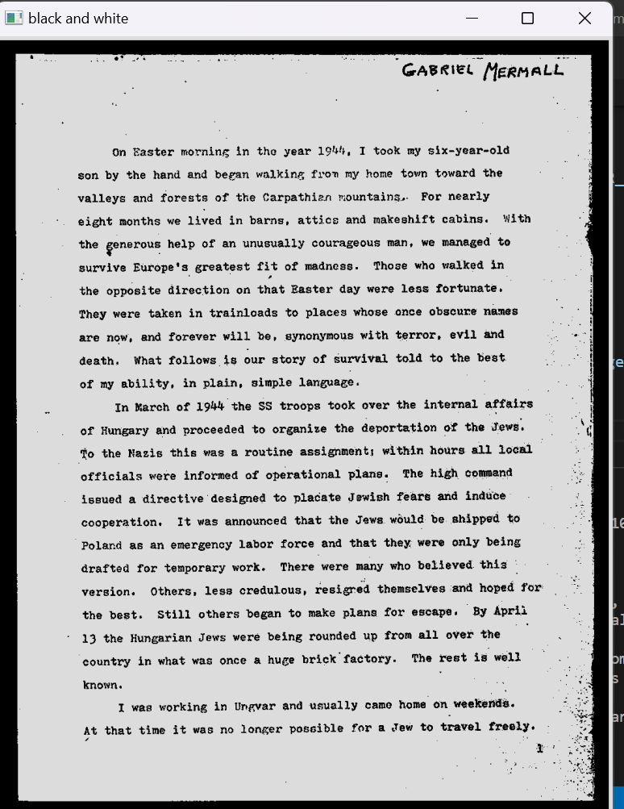
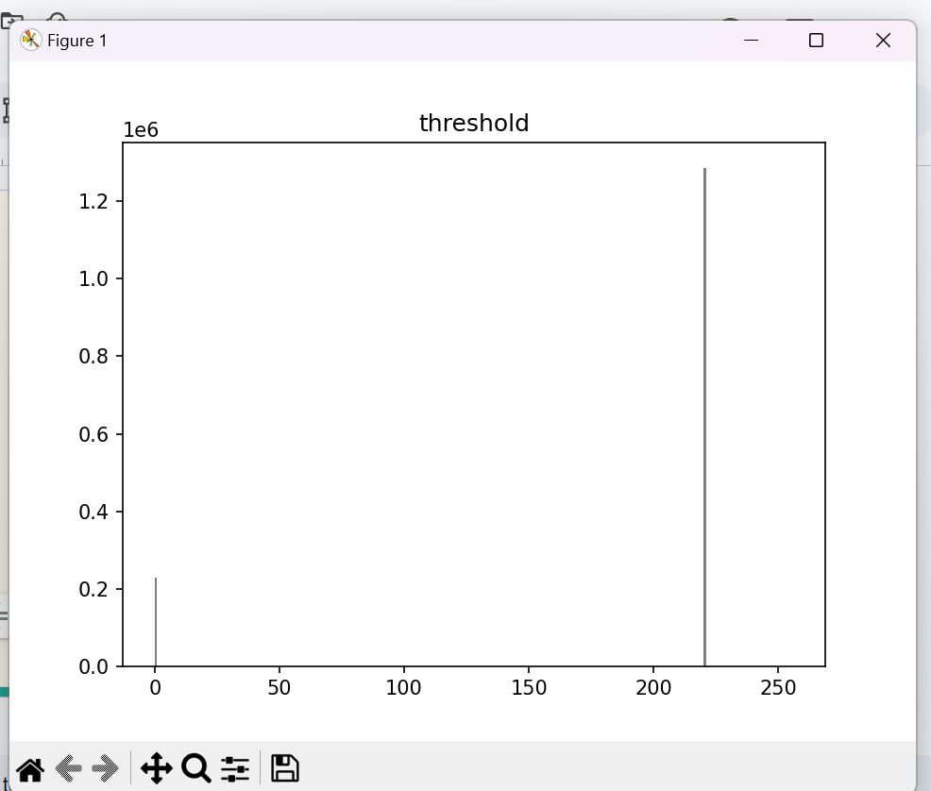
Thresholding

Slide 9
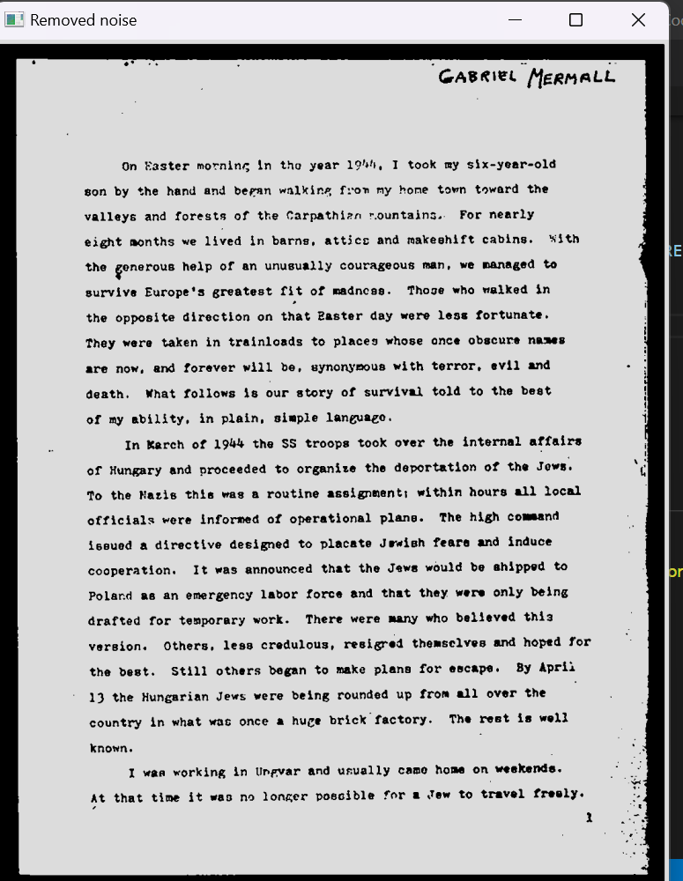
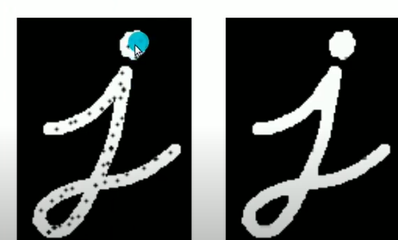
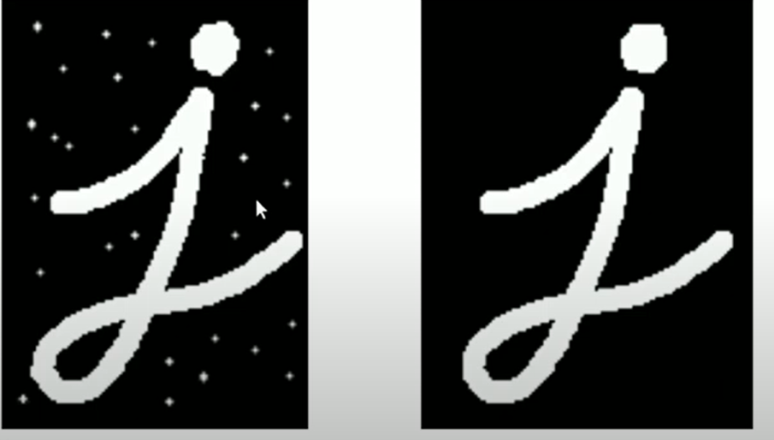
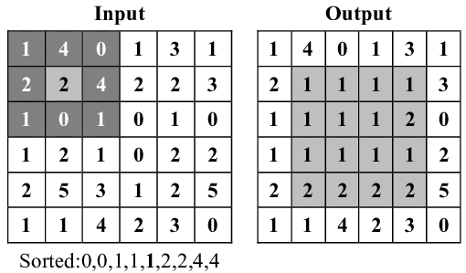
Noise removal
Morphological Close operations
A closing is a dilation followed by an erosion.
Morphological Opening operations
A closing is a erosion followed by an dilation.
Median filter
image = cv2.medianBlur(image , 3 )
Using 3X3 median filter

Slide 10
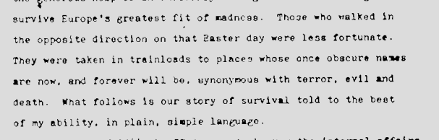
Noise removal
4) Erode
Using 2X2 kernel
kernel = np.ones((2,2),np.uint8)
image = cv2.erode(image, kernel, iterations=1)

Slide 11
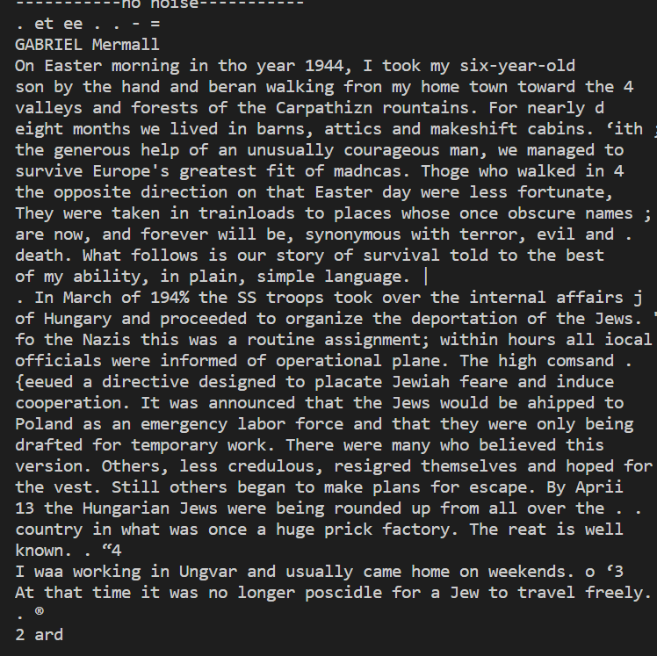
Result
Evaluate the accuracy of the OCR output using metrics such as word error rate (WER) and character error rate (CER).
Before Processing (Approx) WER:
# words in the original text: 244 , # words in the processed text: 65 ,Common words: 9
Word error rate = (244-9)/244 = 0.963
After Processing WER: (Approx)
# words in the original text: 244 , # words in the processed text: 206 ,Common words: 167
Word error rate = (244-107)/244 = 0.315
The total improvement percentage would be:
((96-56)/96) x 100% = 67.70% (approx)

Slide 12
Limitations
For different image different preprocessing might be needed.
Sometime we have to choose threshold value according to image.
We might have to choose Iteration and kernel size of filters according to image.

Slide 13
Thank you!!

